Slide 1
WorlD of
Text
(Seal) Team 6 | Sean Morgenthaler | Molly He | Pietro Sette | Janson Lau | Charlie Hwang
CSCI 201 Final Project

Slide 2
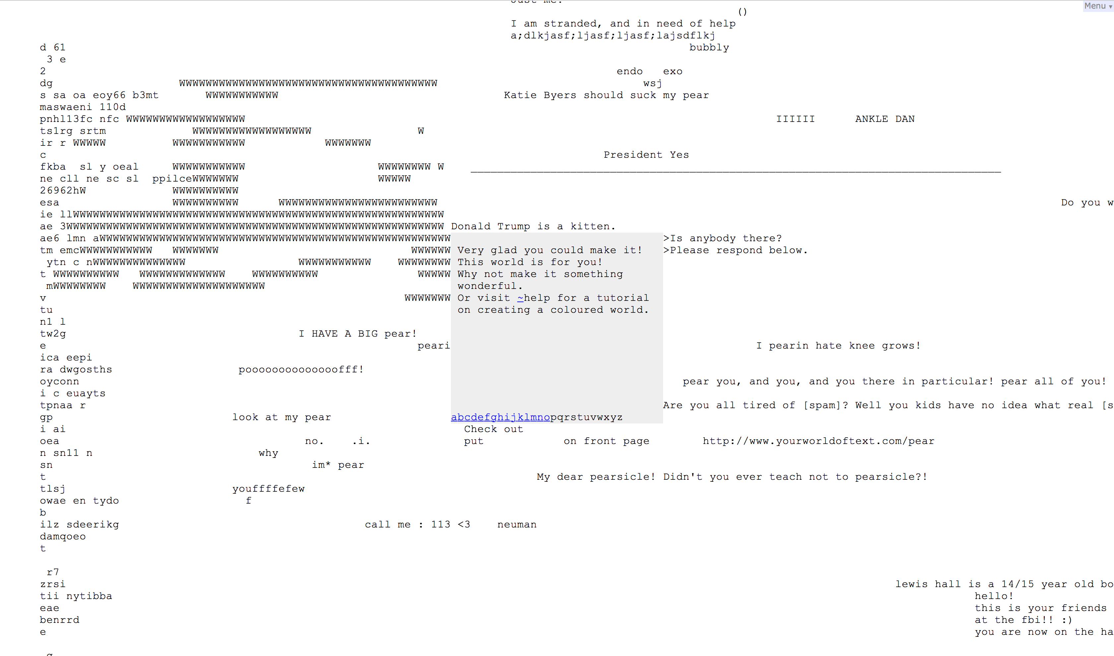
ABOUT
Community Java Application
Text editor with text-styling
Combination of Excel and Google Docs
Inspiration drawn from Your World of Text

Slide 3
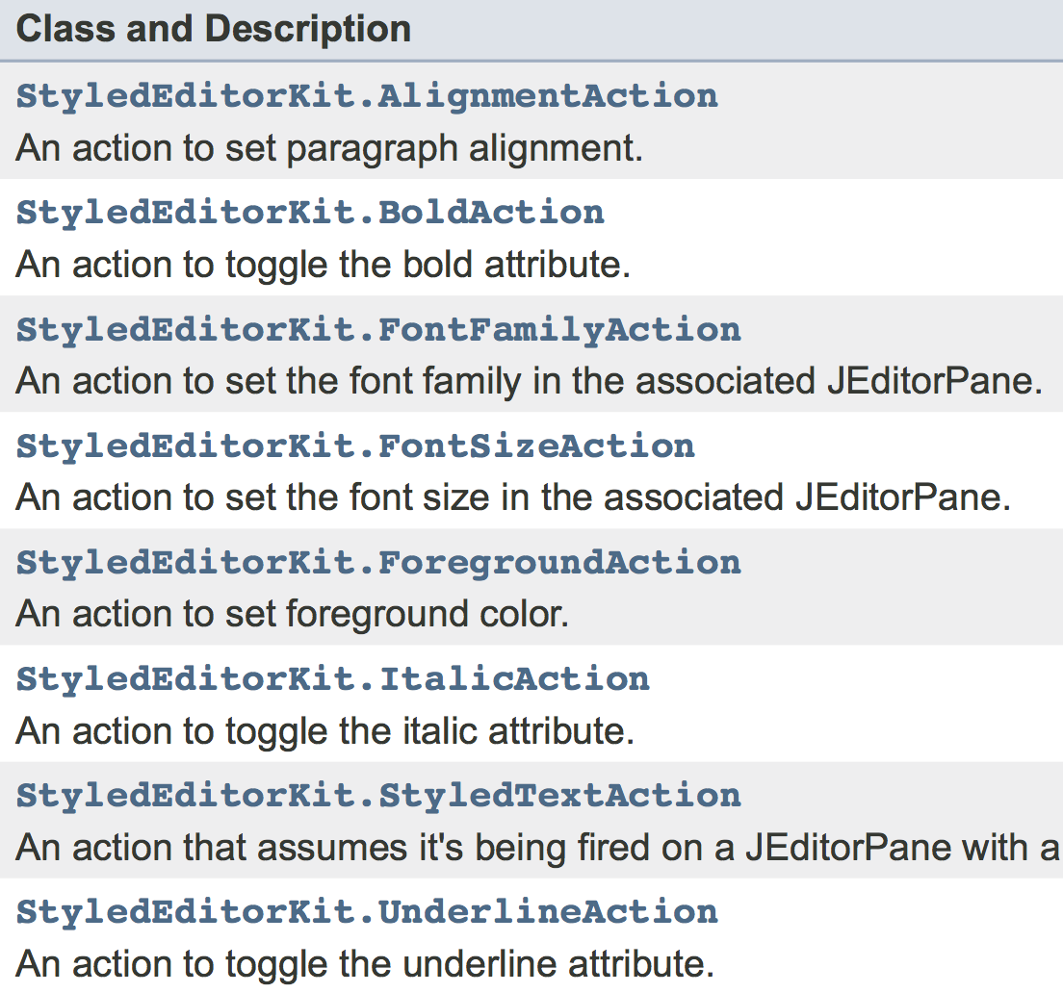
Topics outside
curriculum
JPasswordField
User account security
JTextPane
AttributeSet
Loading window (GIF integration)
StyledEditorKit
JavaFX

Slide 4










SOFTWARE & TOOLS

Slide 5
Development and Design decisions
Problems
Solutions
Teamwork
Messy code merging
Project Design
Be user friendly
Styling implementation
StyleEditorKit limitations
Limiting guest functions
Concurrent modification
Teamwork
“always pull before push”
Project Design
Show/change password, set security questions
Use JTextPane instead of JTextArea
Limited (but useful) features
Hacky listener logic
No “for: each” loops

Slide 6
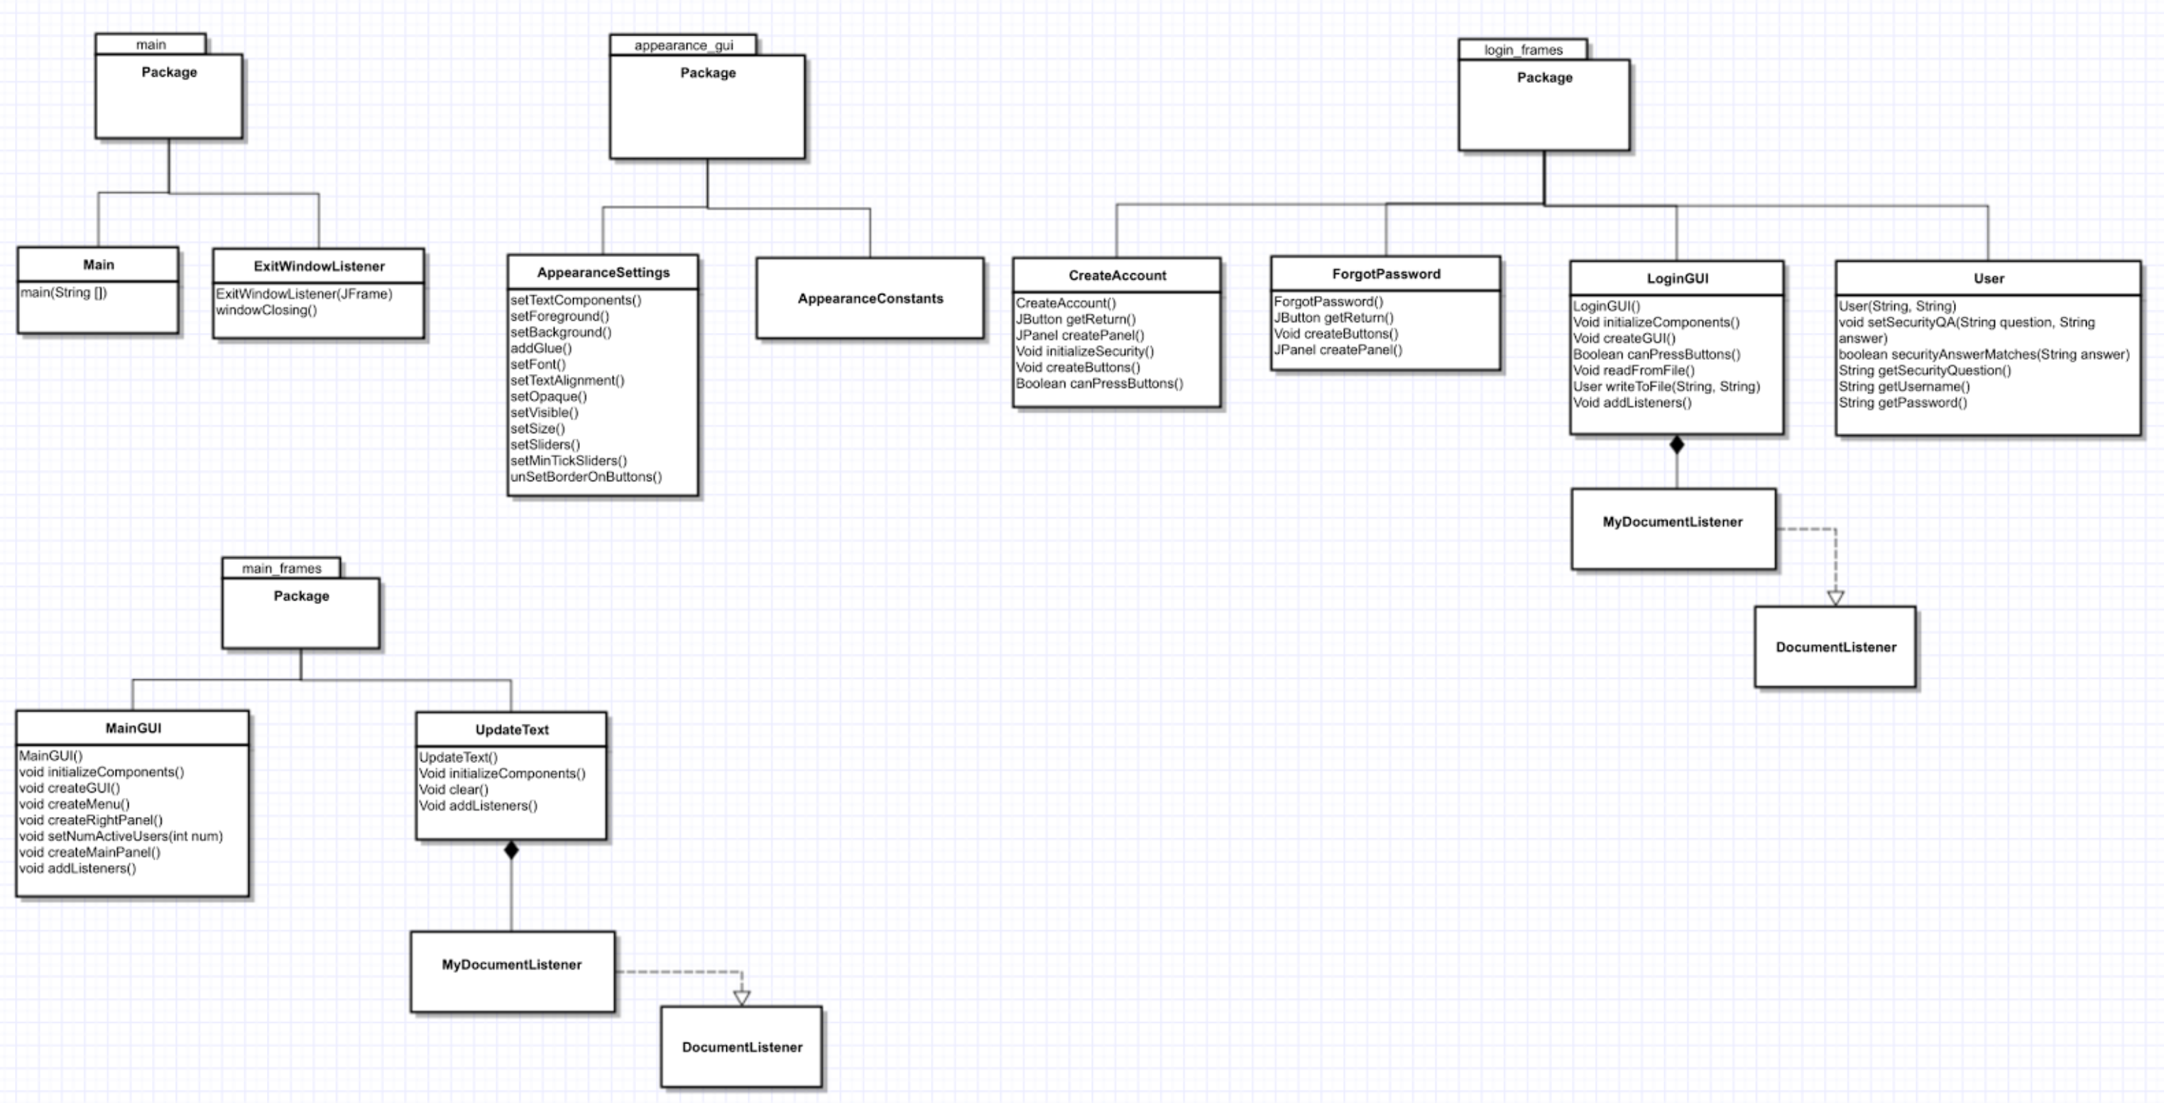
classes
CreateAccount
ForgotPassword
LoginGUI
LoadingWindow
User
Client
Server
NetworkMessages

Slide 7
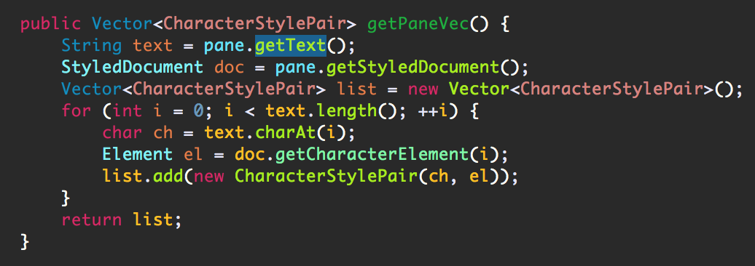
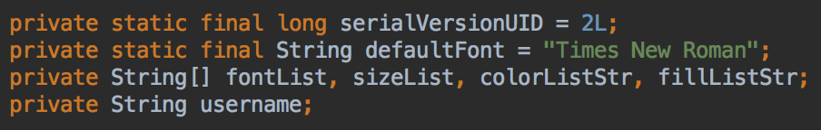
Data structures
Arrays for font styles
Vector for server threads
Vector for synchronized text
Map for underlining text
HashTable for attribute sets

Slide 8
Networking
Client-Server Communication
Client
ServerThread
Server
Initialization of Pane
GetPaneInitial
SendPaneInitial
FailConnecting
Insert Functionality
Update
Remove Functionality
RemoveUpdate
RemoveBulk

Slide 9
Multi-threading
Server listens for new connections & communicates with ServerThreads
ServerThread listens & writes to Clients
Client listens & writes to ServerThread
Safeguards against concurrent modification
Synchronized data structures
Traditional for-loops

Slide 10
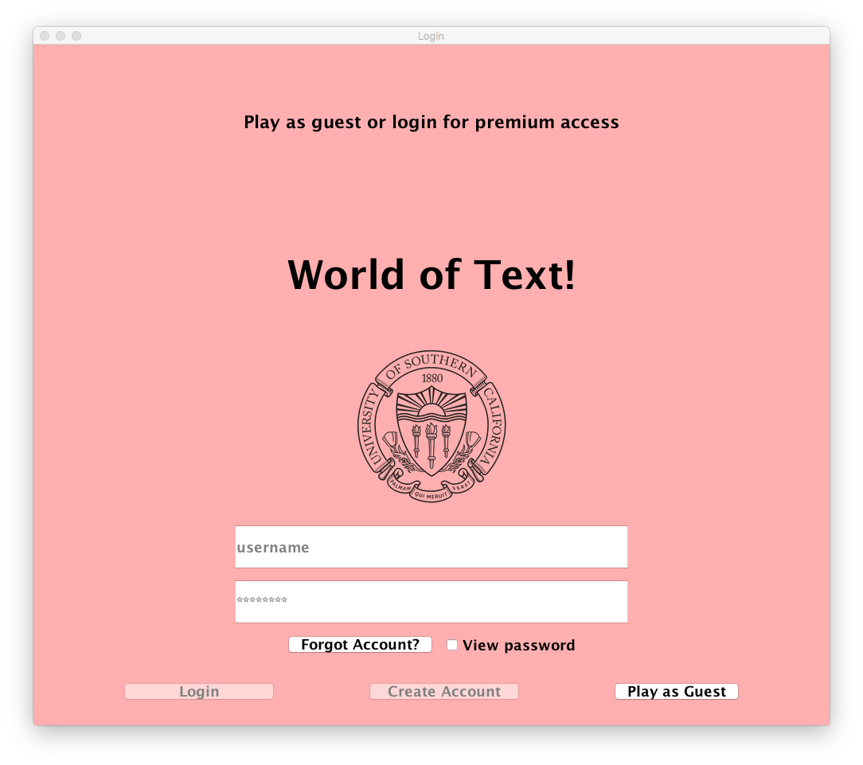
User login functionality
Guest user
Only able to login, create account or input text
Authenticated user
Ability to edit font
Ability to chat with authenticated users

Slide 11
Next steps
Continue JavaFX
Ability to add images
Web Application
Mobile Application

Slide 12
try us out!
Go to this link: goo.gl/Ghm8ma

